Slide 1
Discussion 7 - Linked Lists & Growth
Chris Allsman (they/them)

Slide 2
Administrivia
Ants due tonight
HW6 due tomorrow
MT next Tuesday
No discussion
Lab will be review

Slide 3
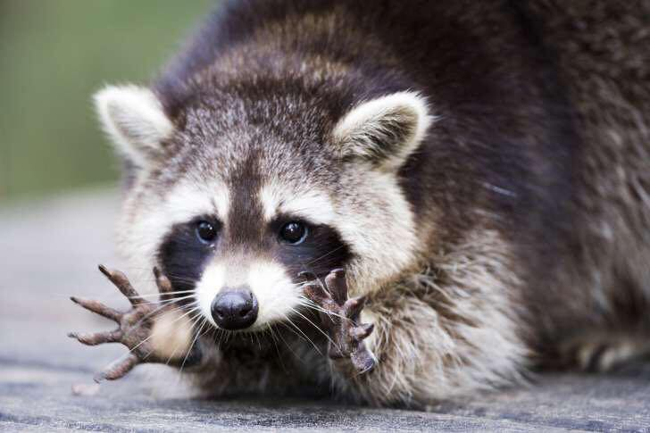
Attendance
links.cs61a.org/chris-disc

Slide 4
Growth
How does our program perform?
How can we measure this?
Time taken to complete?
Average time? Time compared to other programs?

Slide 5
Input Size | Time for f1 | Time for f2
3 | 11 ms | .8 ms
4 | 14.6 ms | 5.4 ms
5 | 18.5 ms | 74.5 ms
6 | 21.2 ms | 450 seconds

Slide 6
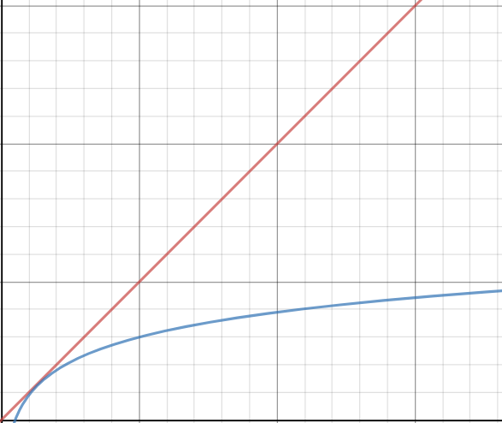

Slide 7
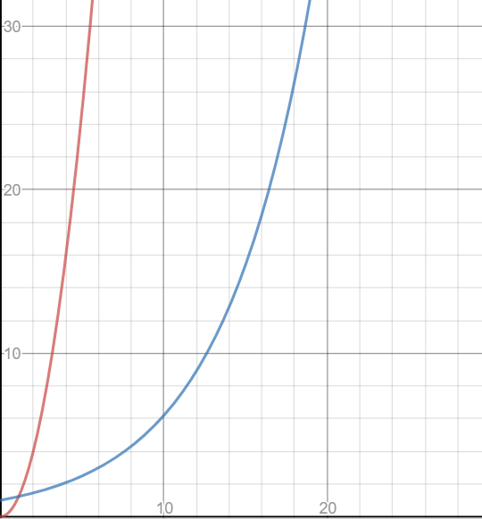

Slide 8
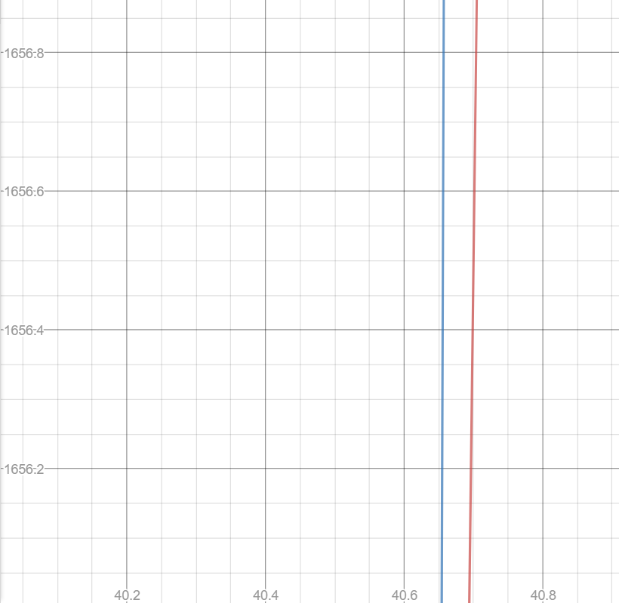
Notes:
So we don’t care exactly how long it takes, but rather how fast it grows as we increase the input size (n)!

Slide 9
Theta Notation
How we describe a function’s growth
Θ(f(n)) = this function grows at rate f(n) as we increase the size of n
Can think of it as: the growth “looks like” f(n)
For those of you that like precise definitions: means that we can bound the growth of the function above and below by some multiple of f(n)

Slide 10
Rules
Only consider behavior for very large inputs
Disregard constant factors
Only take the largest term
Θ(1) < Θ(log n) < Θ(n) < Θ(n log n) < Θ(n^{k}) < Θ(k^{n})

Slide 11
Tips
Know what each growth class means “intuitively”
Θ(1) = same amount of steps regardless of input size
Θ(n) = increasing input size by 1 adds some number of steps
Θ(log n) = multiplying the input size adds some number of steps
Θ(2^{n}) = increasing input size by 1 multiplies the number of steps

Slide 12
Tips
Identify the number of times we evaluate something in a loop structure and how long each evaluation takes
def fact(n):
i, total = 1, 1
while i <= n:
total = total * i
return total
Θ(1) * Ν = Θ(N)

Slide 13
Tips
Θ(1)
N
Draw out a tree for recursive calls
Θ(1)
N - 1
def fact(n):
if n <= 1:
return 1
else:
return n * fact(n-1)
Θ(1)
1

Slide 14
Disregard constant factors
Only take the largest term
Θ(1) < Θ(log n) < Θ(n) < Θ(n log n) < Θ(n^{k}) < Θ(k^{n})
Θ(1) = constant # of steps
Θ(n) = add 1 to n, add steps
Θ(log n) = multiply n, add steps
Θ(2^{n}) = add 1 to n, multiply # of steps
1 + 2 + 3 + … + n = n(n - 1) / 2
a + ar + ar² + … + ar^{n} = a(1 - r^{n})/(1 - r)

Slide 15

Midterm Tips

Slide 16
Taking Midterms
HW/Projects/Discussions are great for familiarizing you with the material
The only way to prep for the midterm is to practice midterm-level questions
That being said…
Focus on the quality of your studying, not the number of tests you take

Slide 17
How I Practice Midterms
Take your first midterm blind
Don’t worry if you’re unprepared
Don’t take it with the textbook/lecture notes open
Don’t worry if you feel like you didn’t get anything
After you’ve spent at least 10-15 min on every problem:
Debrief each question. What did you know? What didn’t you know?
Take notes on it, and take some time to go back and study those areas

Slide 18
How I Practice Midterms
For each midterm you take, also identify areas that you struggle with, but also:
Build your cheat sheet. If you make same the mistake more than once, make sure to put it on there
When you look at the solutions, take some time to debrief. How could you get to this solution in the future? What in the skeleton/doctests would help you?

Slide 19
How I Practice Midterms
Don’t worry when you struggle with a problem
The most important thing is recognizing patterns and developing problem solving strategies
If you follow the previous suggestions, you’ll get better at these with each question you get through!

